Slide 1
Data Science Methods for Clean Energy Research
Feb 7, 2019
You will need the HCEPD_100K.csv file (or the path to it) for python example time today
Notes:
Linear regression is our starting point for more advanced methods.
Slight difference to what you’re used to though.
In normal descriptive statistics, we use regression parameters to describe our data.
In data science, we perform regression in a training dataset to make predictions on another dataset.

Slide 2
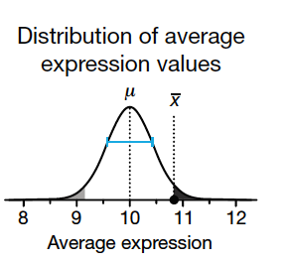
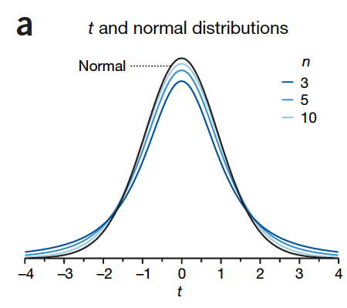
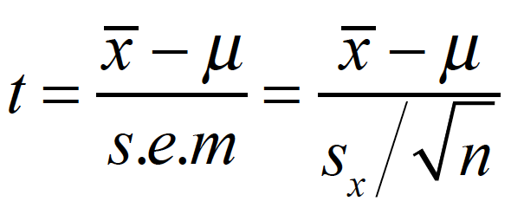
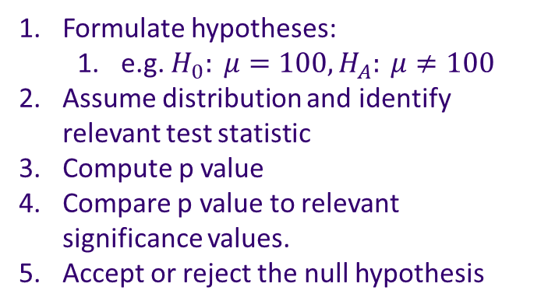
Hypothesis Testing
Formulate hypotheses:
e.g. $H_{0}: μ=100, H_{A}: μ≠100$
Assume distribution and identify relevant test statistic
Compute p value
Compare p value to relevant significance values.
Accept or reject the null hypothesis

Slide 3
Outline
Simple linear regression
The model
The training
The error
In the coefficients
In the model
Making predictions with the model
Multiple regression

Slide 4
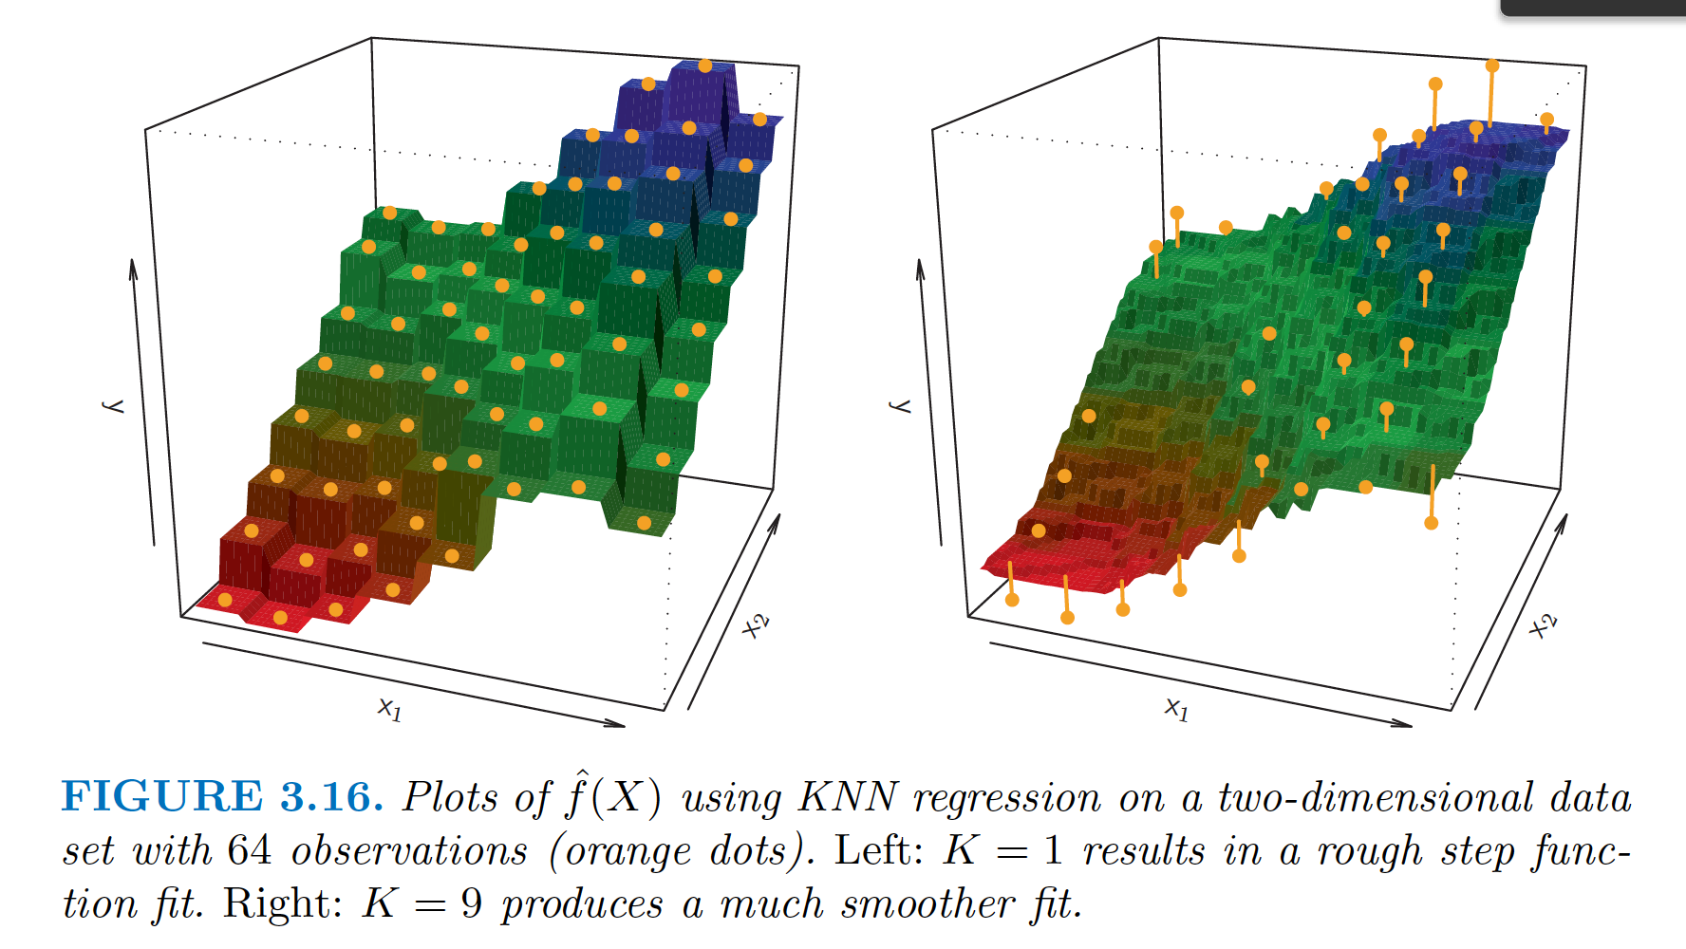
Regression
Notes:
We talked about KNN for classification problems, but what does that mean when you use it in a regression setting?
Here’s an example.
Think of it as a moving average.

Slide 5
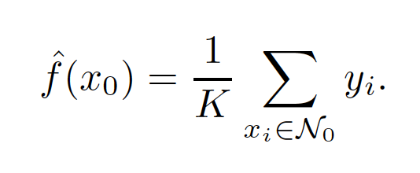
Regression with KNN
How would you do it?

Slide 6
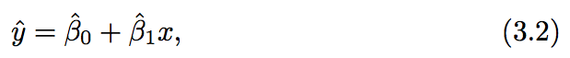
Simple linear regression (SLR)
The regression framework (generic in supervised machine learning)
Propose a model
Define the error metric
Estimate the coefficients and assess the estimate
Determine the error in the model
The humble SLR
Distinguishing the estimates we make with the training data (hat) from the proposed actual coefficients/responses…
Notes:
Regression problems have quantitative outputs.

Slide 7
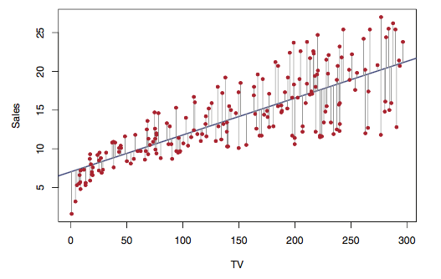
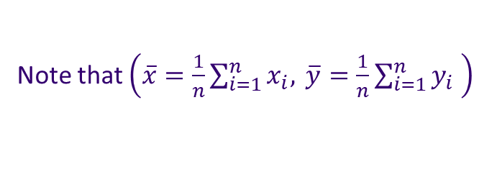
Simple linear regression (SLR)
Residuals
The difference between the observed value of the dependent variable (y) and the predicted value (ŷ) is called the residual (e).
Note that $\left(\overline{x}=\frac{1}{n}\sum_{i=1}^{n}{x_{i}, }\overline{y}=\frac{1}{n}\sum_{i=1}^{n}{y_{i} }\right)$
Top: Fig 3.1 ISL

Slide 8
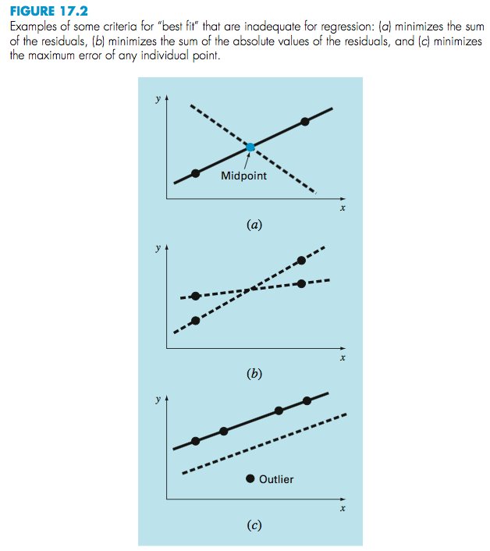
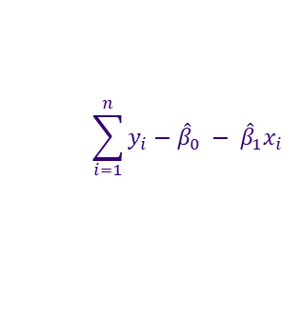
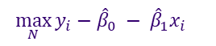
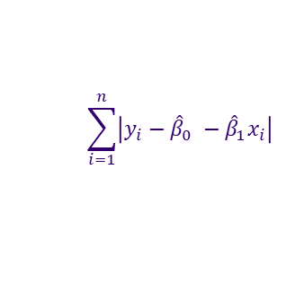
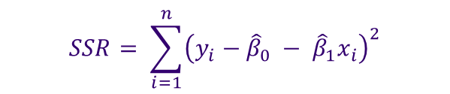
Once the SLR model is known, what is the error?
The SSR describes the sum of squared residual errors, very similar in concept to the MSE we discussed last week
$$\sum_{i=1}^{n}{y_{i}−{\hat{β}}_{0} − {\hat{β}}_{1}x_{i}}$$
$$SSR= \sum_{i=1}^{n}{{\left(y_{i}−{\hat{β}}_{0} − {\hat{β}}_{1}x_{i}\right)}^{2}}$$
$$\sum_{i=1}^{n}{\left|y_{i}−{\hat{β}}_{0} −{\hat{β}}_{1}x_{i}\right| }$$
$${\max_{N}{y_{i}−{\hat{β}}_{0} − {\hat{β}}_{1}x_{i}}}_{}$$
Top: Fig 3.1 ISL
Right: Figure 17.2 from Chapra and Canale numerical methods for Engineers

Slide 9
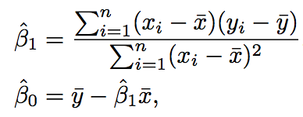
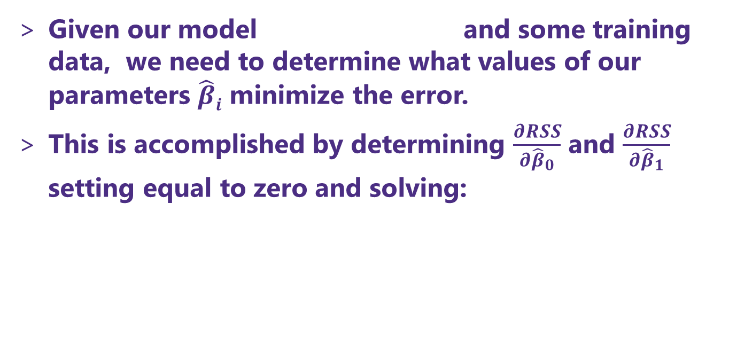
The method of “least squares” minimization
Given our model and some training data, we need to determine what values of our parameters $\hat{β}i$ minimize the error.
This is accomplished by determining $\frac{∂RSS}{∂{\hat{β}}_{0}}$ and $\frac{∂RSS}{∂{\hat{β}}_{1}}$ setting equal to zero and solving:
Notes:
Because the RSS is differentiable in the case of SLR, we can take the derivative.

Slide 10
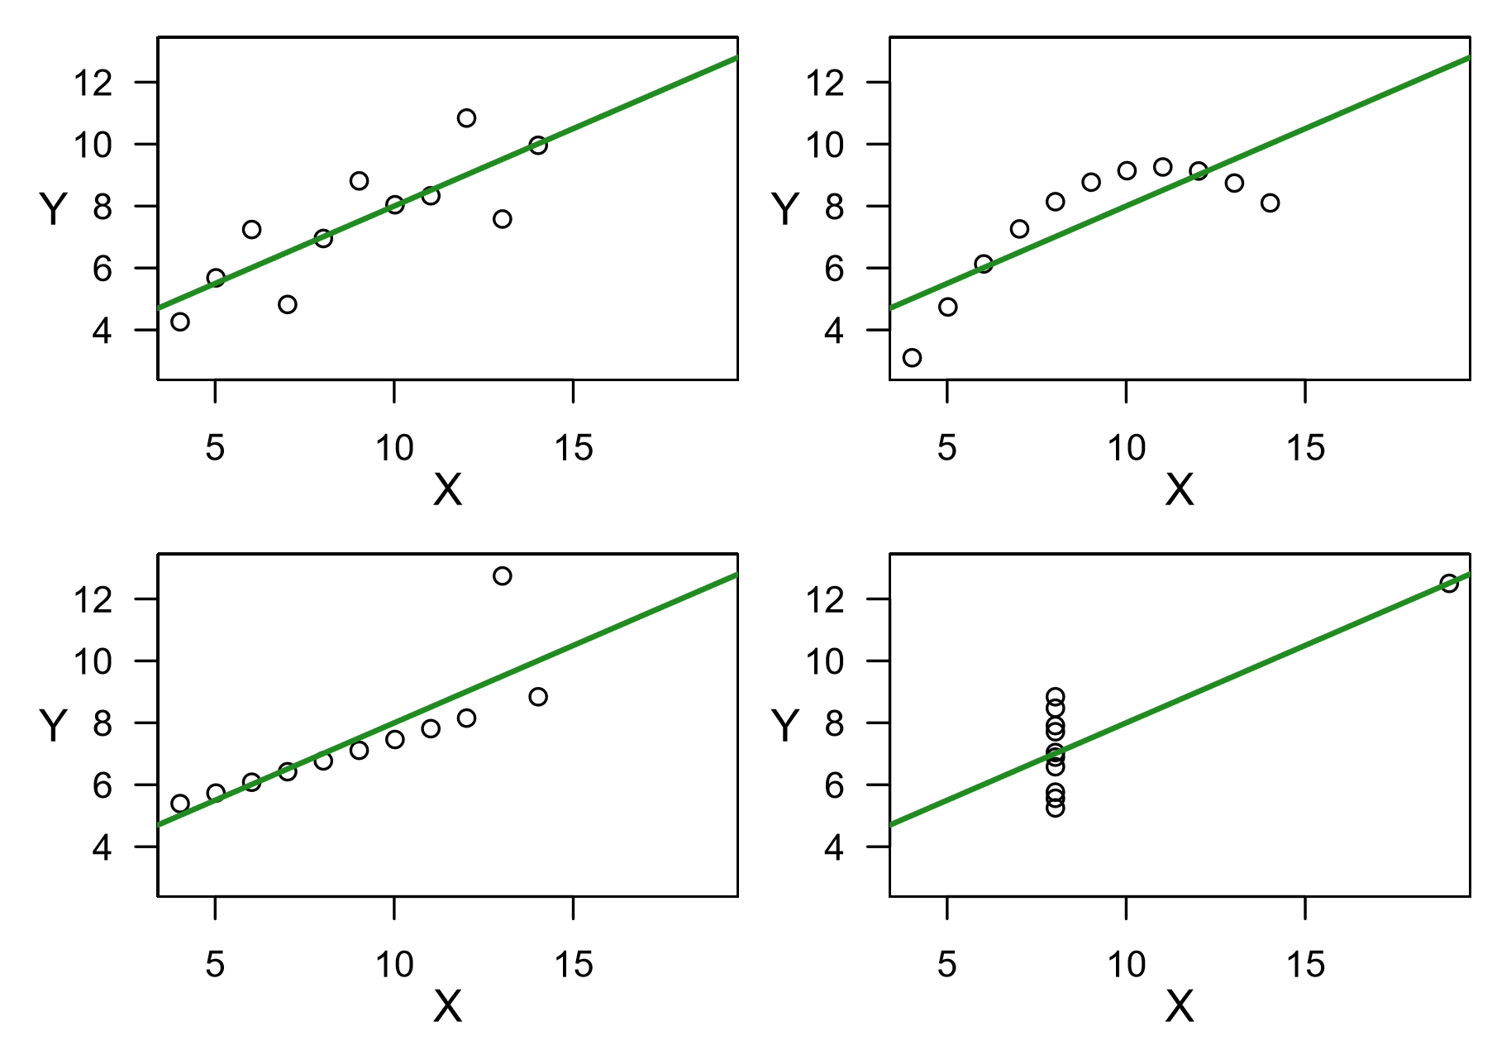
A warning: not all regressions are equivalent
All the summary lines have intercept=3.0, slope=0.5
Adapted from K. Rice (2017)

Slide 11
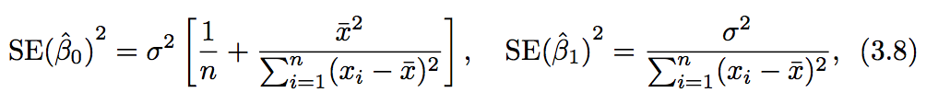
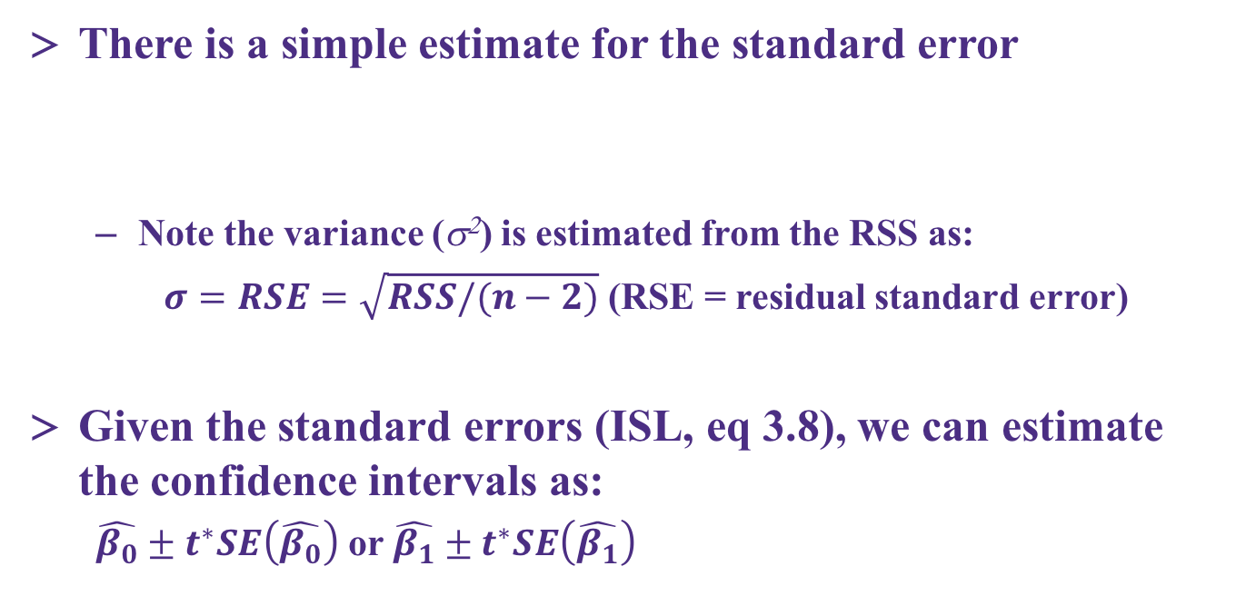
Ways to estimate the uncertainty in the coefficients
There is a simple estimate for the standard error
Note the variance (s²) is estimated from the RSS as:
$σ=RSE=\sqrt{RSS/(n−2)}$ (RSE = residual standard error)
Given the standard errors (ISL, eq 3.8), we can estimate the confidence intervals as:
$\hat{β_{0}}±t^{∗}SE\left(\hat{β_{0}}\right)$ or $\hat{β_{1}}±t^{∗}SE\left(\hat{β_{1}}\right)$
Notes:
BUT you can also get error bars on these by bootstrapping.
The SE for the slope is smaller when the data are more spread out (more leverage)
The SE for the intercept is the same as that of the mean is mean(x) is 0.

Slide 12
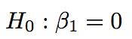
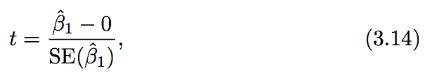
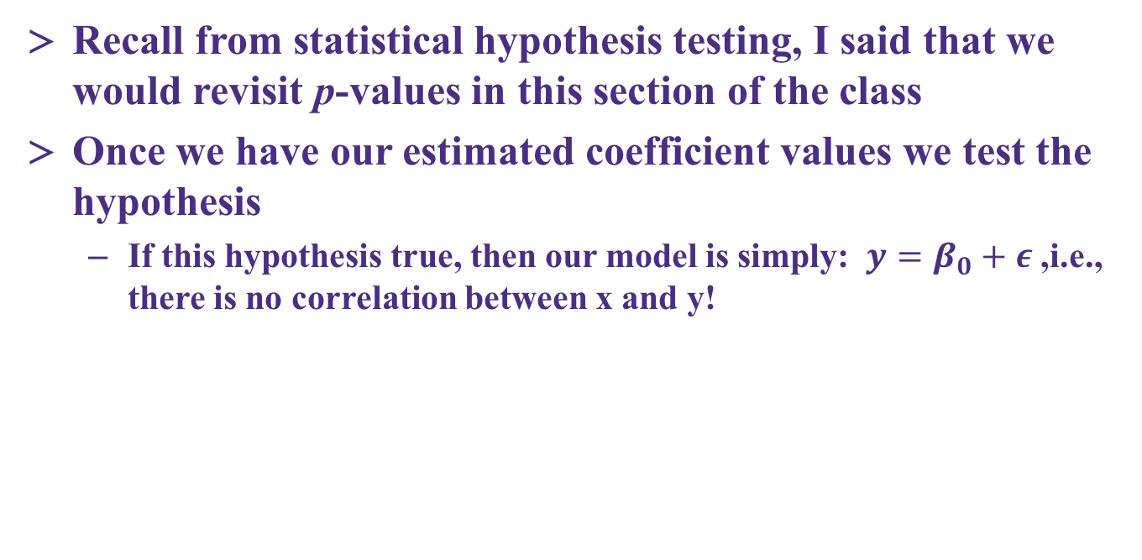
Hypothesis testing on the coefficients
Recall from statistical hypothesis testing, I said that we would revisit p-values in this section of the class
Once we have our estimated coefficient values we test the hypothesis
If this hypothesis true, then our model is simply: $y=β_{0}+ε$ ,i.e., there is no correlation between x and y!

Slide 13
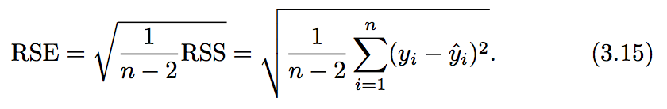
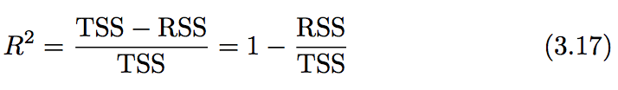
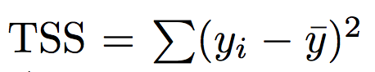
Accuracy of the model – how are we doing overall?
Residual standard error
A measure of the lack of fit of your model (in units of Y!)
R² statistic
A scale invariant measure (0-1 range) that explains ”the proportion of the variability of Y that is explained by X”
TSS measures the total variance in the response Y , and can be squares thought of as the amount of variability inherent in the response before the regression is performed.

Slide 14
Accuracy of the model – how are we doing overall?
R² statistic
A scale invariant measure (0-1 range) that explains ”the proportion of the variability of Y that is explained by X”
TSS measures the total variance in the response Y, and can be squares thought of as the amount of variability inherent in the response before the regression is performed.
RSS is the amount of variability that is left unexplained after performing the regression.
TSS− RSS measures the amount of variability in the response that is explained (or removed) by performing the regression, and R2 measures the proportion of variability in Y that can be explained using X .

Slide 15
Quick example of SLR and P-value calculation with scikit-learn
Grab the notebook for today and practice some SLR

Slide 16
Logistic regression for classification

Slide 17
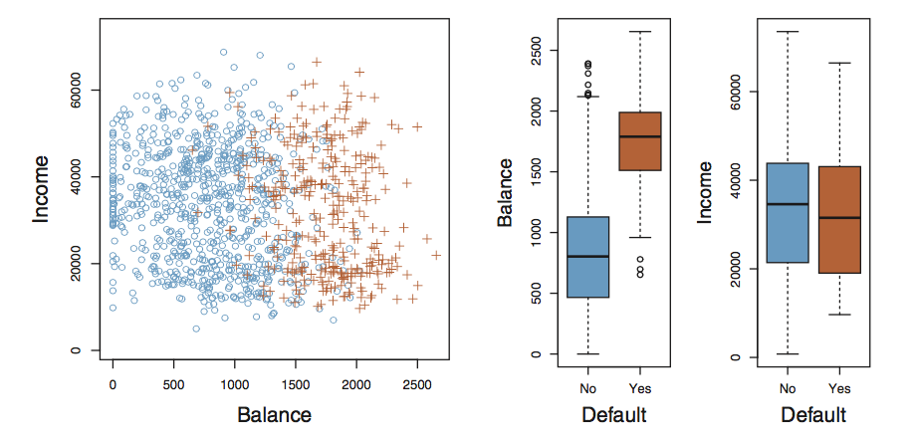
Classification with the logistic model
Key concepts
Consider the data below (ISL Fig 4.1), we are trying to make a guess as to whether someone will default on a loan on the basis of their bank account balance and income level
Questions?

Slide 18
Classification with the logistic model
As we said in class, performing regression on discrete classes is arbitrary (what are the outputs we assign to Yes/No and why?)
One caveat is the binary (two level response). Here we can always use a 0/1 coding!
Lets look at simple regression on this data

Slide 19
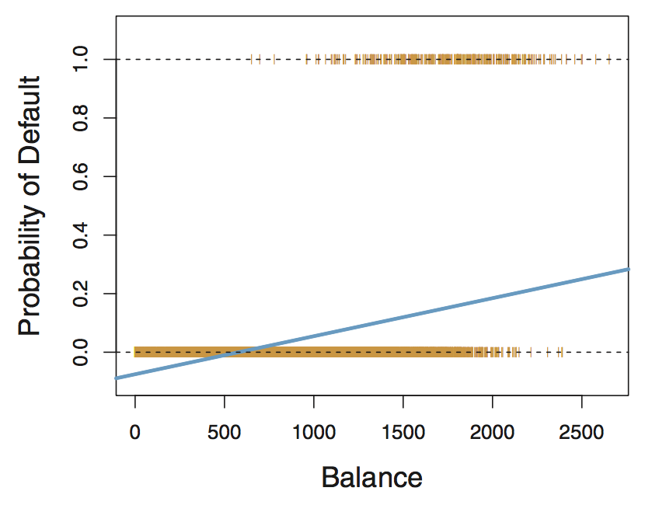
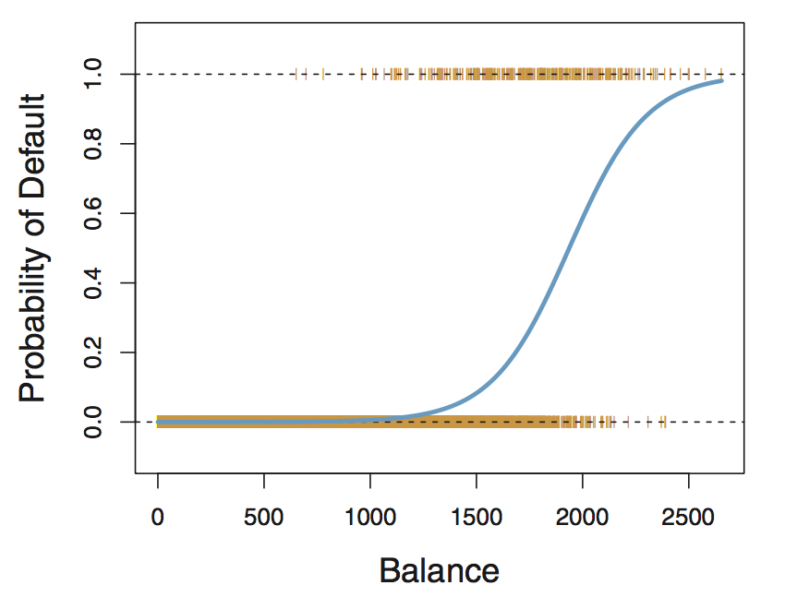
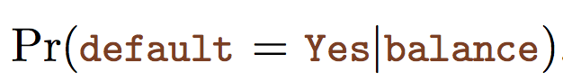
Classification with the logistic model
Fig 4.2 (left) shows us the outcome of simple linear regression using a 0/1 coding for the probability of default (0.0 or 1.0)
What does the model predict for Balance < $500?
Fig 4.2 (right) shows us the outcome of regression using a different functional form to describe situation where our variables are bounded between 0 and 1
This is modeled using the logistic function, which lets us sensibly answer this question: “what is the probability of default given some balance?”

Slide 20
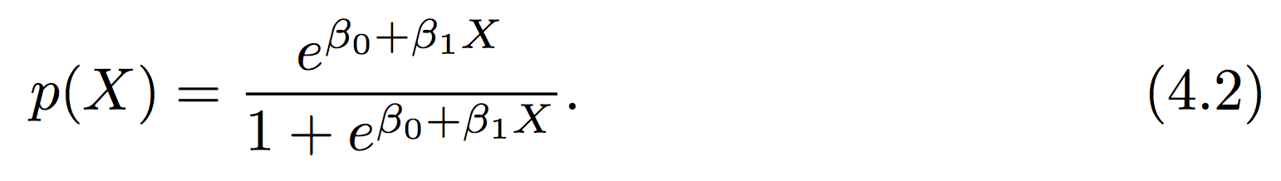
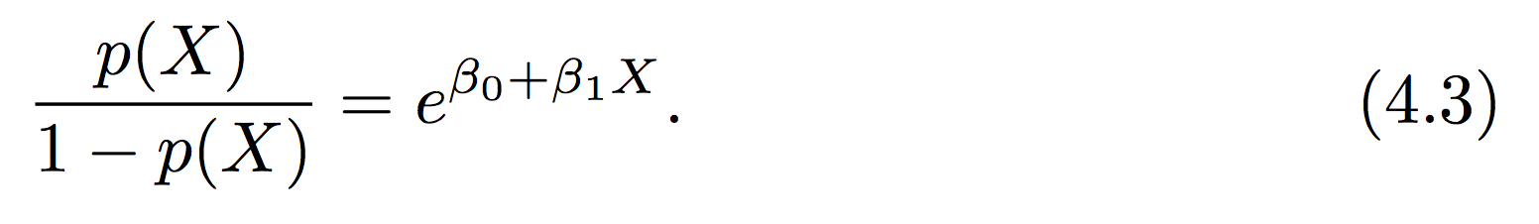
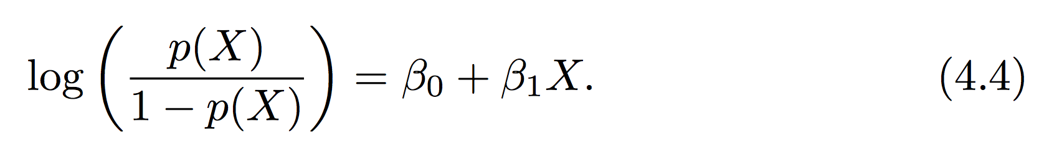
The logistic function
The logistic equation (4.2) provides a smooth transition between 0 and 1
Compare simple linear model and logistic eq
In terms of the “odds”
Can anyone define “odds”? If your probability of success is 1 in 5 (0.2) , your odds of success are 1 in 4: 0.2 / (1-.2) = .25
Log of the odds is the “logit”, relates the change in log of odds of success w/change in X
Notes:
Odds are the probability it happens, divided by the probability it doesn’t.
Probability scales from 0 to 1. Odds scales from 0 to infinite.
Use in horse racing. Better related to correct betting strategy.

Slide 21
Is the logistic model a classifier?
Yes!
Given a class situation “e.g., default vs. non-default”, the logistic model can take a set of training data and give a function that makes a prediction about what class a new or different input would be in
P < 0.5 = no default vs. P >= 0.5 default
We can also use a binary response (e.g., 0 vs 1) and train a multiple logistic model (e.g., many X_{i})
We could also use multinomial logistic models to describe a situation with >2 classes

Slide 22
Basic concept of logistic regression
(much more next two weeks on regression!)
For reasons we won’t discuss in detail standard regression models don’t work well on the logistic equation.
But we still need to determine our coefficients: β_{i}
This is done through a procedure called maximum likelihood estimation
The basic idea is that we seek to find the set of β_{i} that maximizes the probability of making the correct prediction

Slide 23
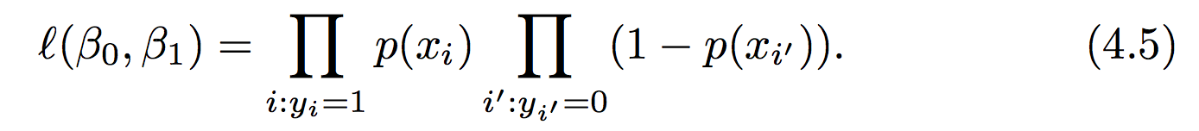
Simple illustration of MLE
The likelihood function can be defined in terms of the product of all the probabilities
In the case of the binary (0 vs 1) scenario:
Recall each probability is defined by our logistic eq:
We seek the values of β_{i} that maximize 4.5

Slide 24
Example and implementation in Python
We saw earlier that there is a python library “sklearn” (sci-kit learn), that can be used to perform machine learning techniques
Monday example: KNN
We will use many other ML methods from sklearn this quarter
Sometimes practice in class, sometimes practice on HW, sometimes example in class notes

Slide 25
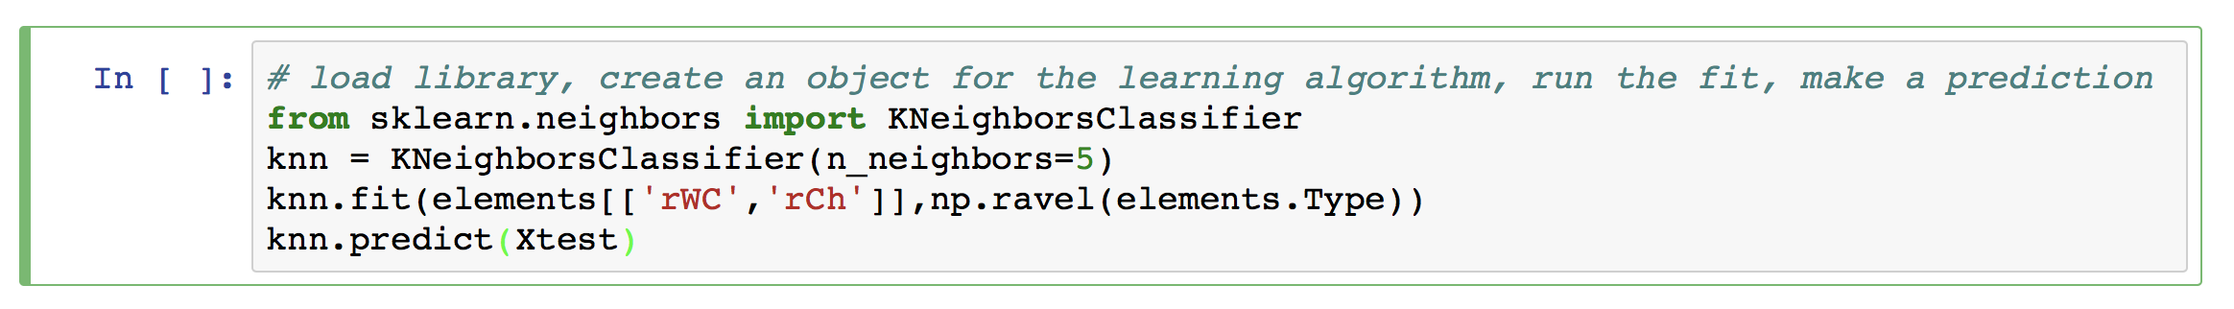
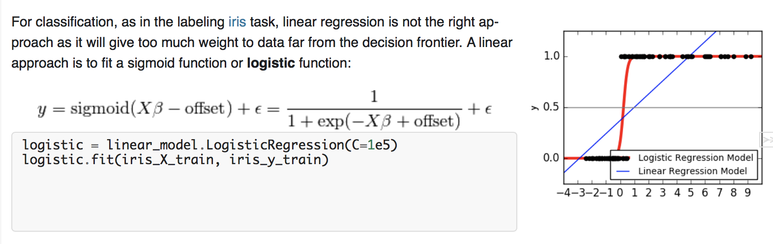
Example and implementation in Python
Recall key elements of our KNN model using sklearn:
Logistic regression is similar:
From sklearn tutorial

Slide 26
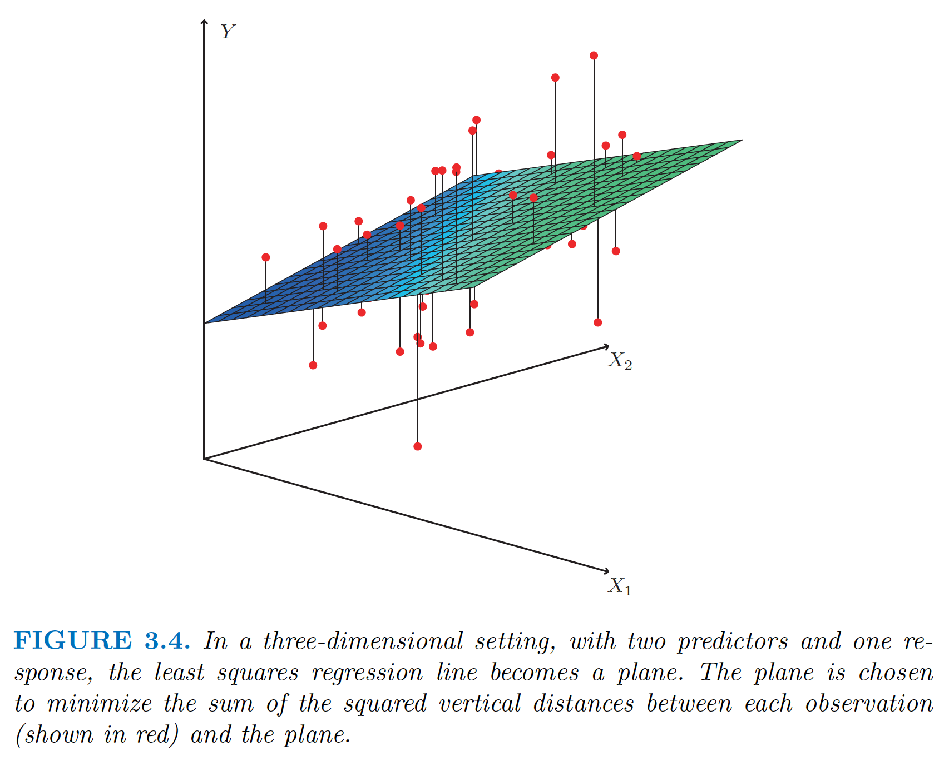
Multiple regression

Slide 27
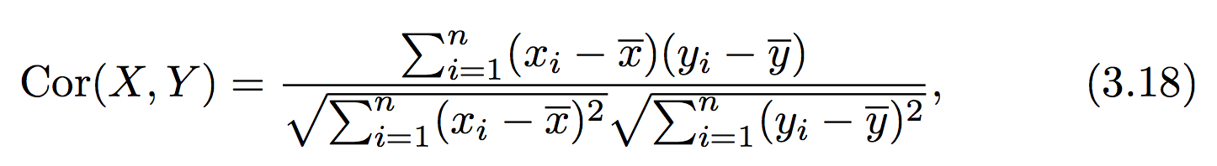
The correlation
(we will need this in multiple regression)
Recall the basic descriptor – correlation coefficient or simply correlation, which we use to describe trends in our data and relationship between variables

Slide 28
Multiple regression
Concept: independently assess the variation in Y with different values of X:
As with SLR, the coefficients are determined by setting the analytical partial derivatives to zero and solving the resultant p+1 linear equations
As with SLR there is an exact solution
Will not show math, but easily found online

Slide 29
Key questions with multi-parameter fits
Section 3.2.2 in ISL does an excellent job of discussing the following four key questions in the context of an MLR fit for marketing/sales data
Is at least one of the predictors X1 , X2 , . . . , Xp useful in predicting the response?
Do all the predictors help to explain Y, or is only a subset of the predictors useful?
How well does the model fit the data?
Given a set of predictor values, what response value should we predict, and how accurate is our prediction?
4 Q directly copied from ISL page 75!

Slide 30
Big picture concepts
Tempting to simply add one term for each feature in X and see how good of a fit we obtain, but that doesn’t give us much inference
There is a huge risk of overfitting with using a lot of parameters!
We can use a new type of hypothesis test to find out if any of the parameters are significant
We can use some algorithms (selection algorithms) to try and reduce the number of parameters

Slide 31
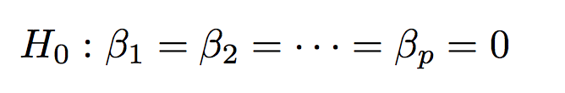
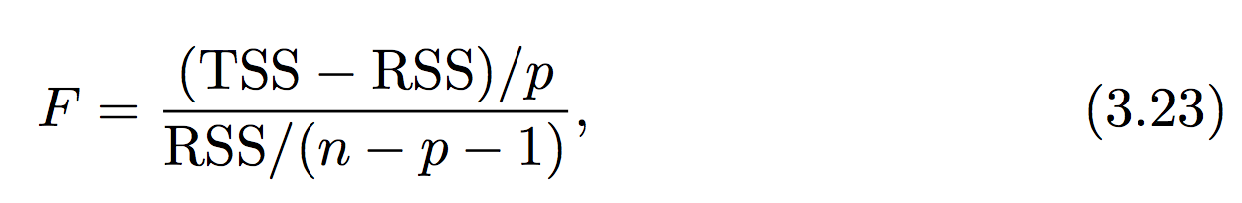
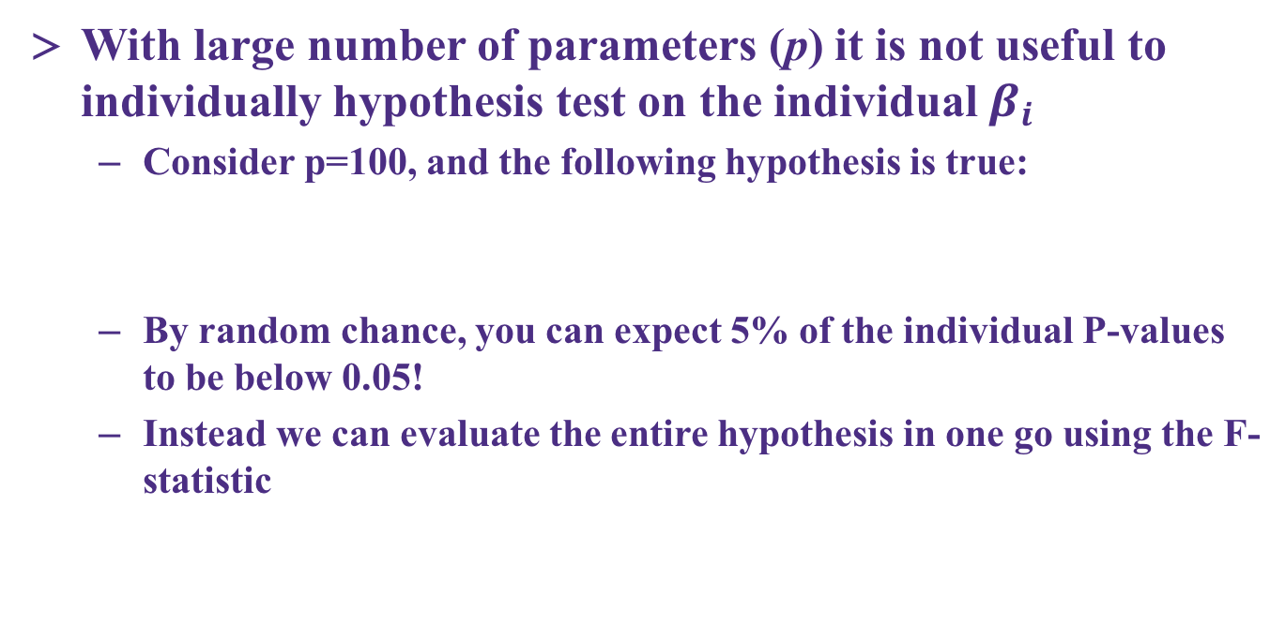
Multiple regression and the F-score
With large number of parameters (p) it is not useful to individually hypothesis test on the individual $β_{i}$
Consider p=100, and the following hypothesis is true:
By random chance, you can expect 5% of the individual P-values to be below 0.05!
Instead we can evaluate the entire hypothesis in one go using the F-statistic

Slide 32
Multiple regression and the F-score
The F-statistic has a penalty for increasing the number of parameters (this should make sense!)
Recall from the t-statistic, we had a specific recipe to test the hypothesis at a certain significance level (e.g., α=0.05)

Slide 33
Multiple regression and the F-score
How large does the F-statistic need to be before we can reject H0 and conclude that there is a relationship?
It turns out that the answer depends on the values of n and p.
N is large, an F-statistic that is just a little larger than 1 might still provide evidence against H0.
A larger F-statistic is needed to reject H0 if n is small.
Generally use stats software to find P(F) to get p-value

Slide 34
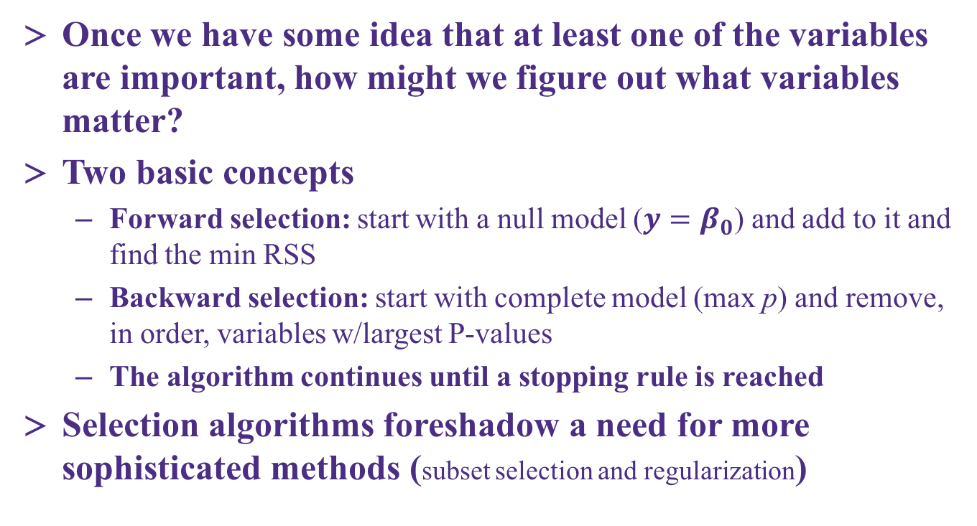
Which of the variables are important?
Once we have some idea that at least one of the variables are important, how might we figure out what variables matter?
Two basic concepts
Forward selection: start with a null model (${y=β}_{0}$) and add to it and find the min RSS
Backward selection: start with complete model (max p) and remove, in order, variables w/largest P-values
The algorithm continues until a stopping rule is reached
Selection algorithms foreshadow a need for more sophisticated methods (subset selection and regularization)

Slide 35
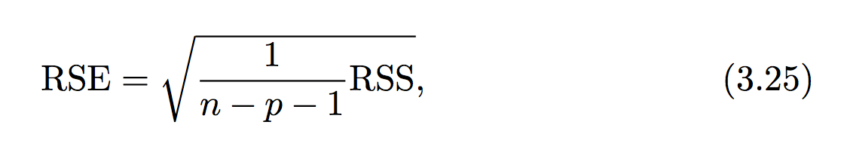
Residual squared error (RSE) in MLR
Our error metric for the goodness of fit of the model also includes a penalty for increasing p compared to n
With an multiple linear regression model in hand, you can make predictions and also trivially add confidence intervals, just as with simple linear regression

Slide 36
When good assumptions go bad
We haven’t discussed it in detail but there are three key assumptions that have been used to build our linear regression model:
Errors are uncorrelated and normally distributed
The variance of the error (in Y) is independent of where we are in X
Liner relationship between X and Y (the predictor-response relationship)
Individual contributions of your X’s are piecewise additive to the response
These assumptions underlie many methods we commonly use!

Slide 37
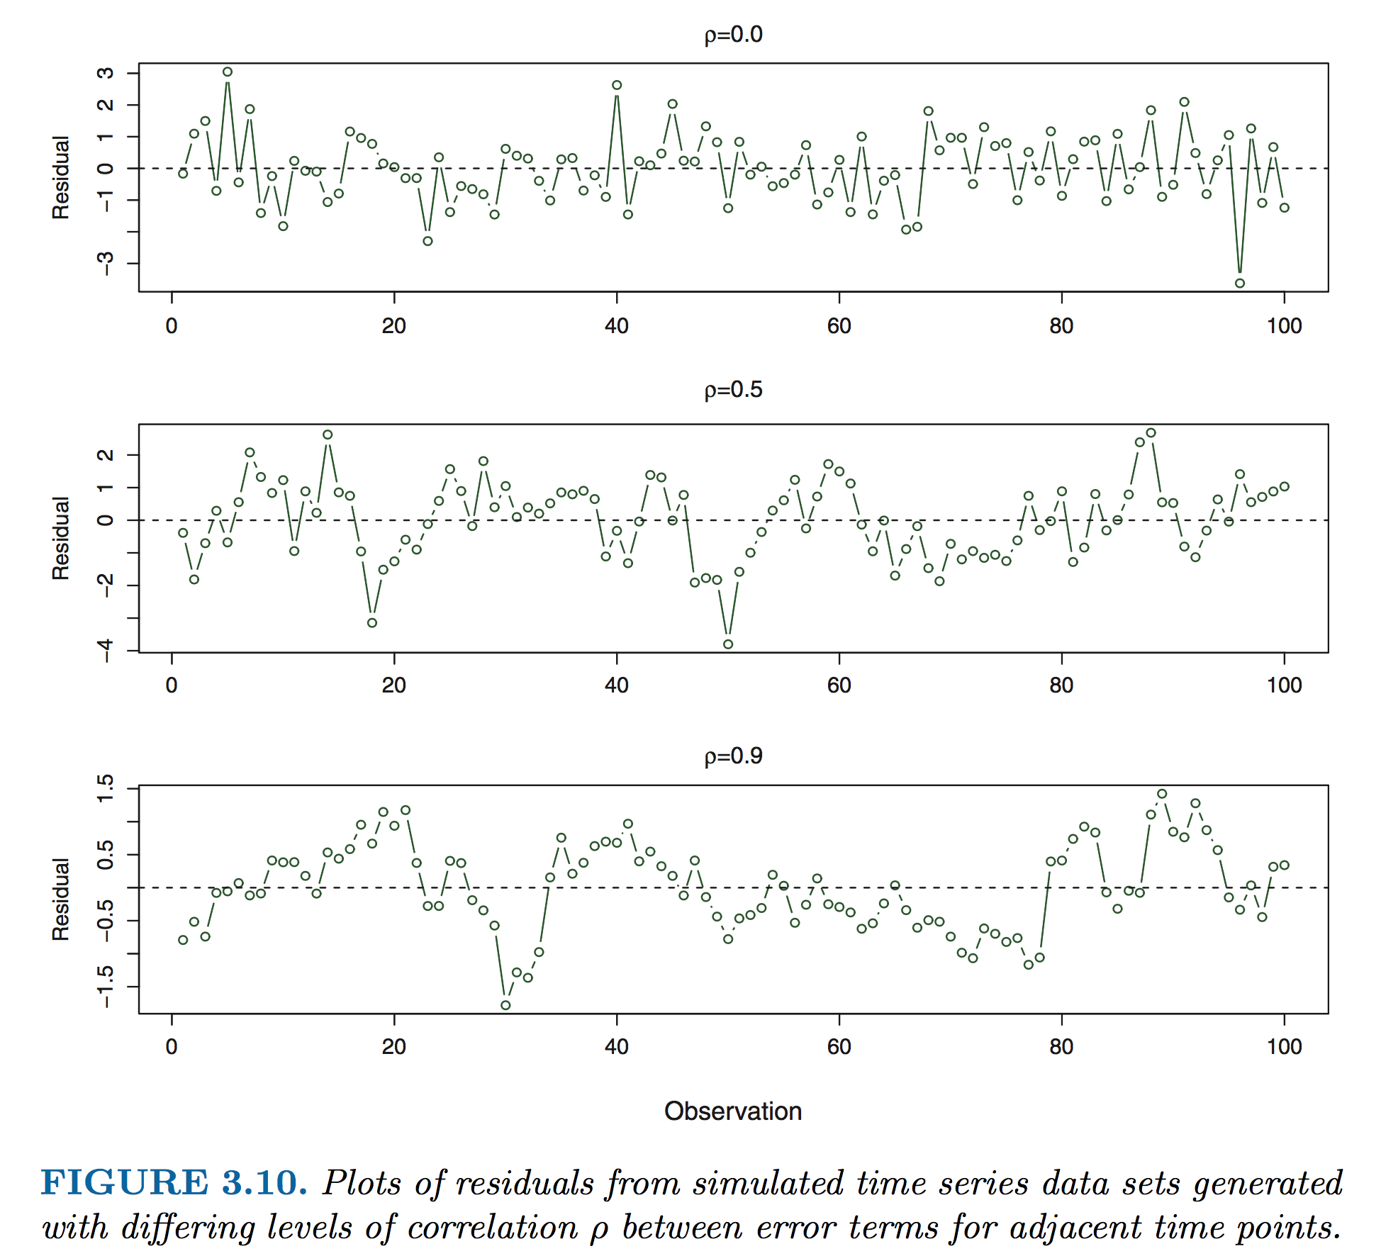
Understanding correlation in error
The most common way that error becomes correlated is with time series data

Slide 38
Identifying correlation in error
Note that the plot in the last slide was residual vs. observation (always a good idea to plot this in addition to a histogram of your residuals – both whether our assumptions are in line)
Introduction and practical implementation of methods to deal w/correlated errors is beyond scope of this class but we can discuss a few principles
The autocorrelation time is the correlation of a signal with a delayed copy of itself as a function of delay.
Fast Fourier transforms (FFT)

Slide 39
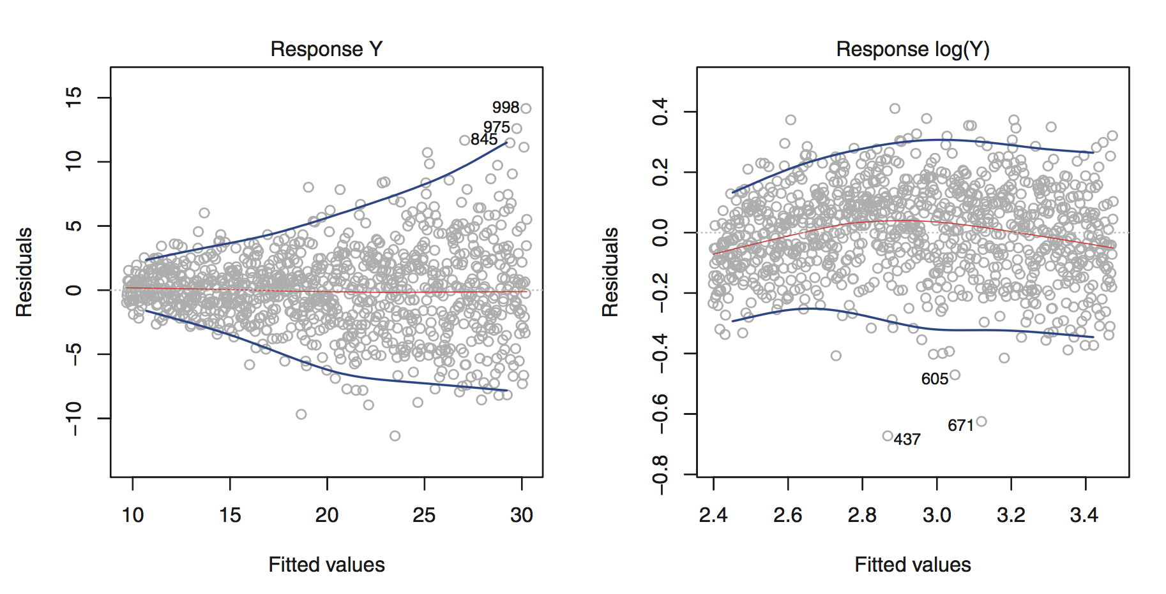
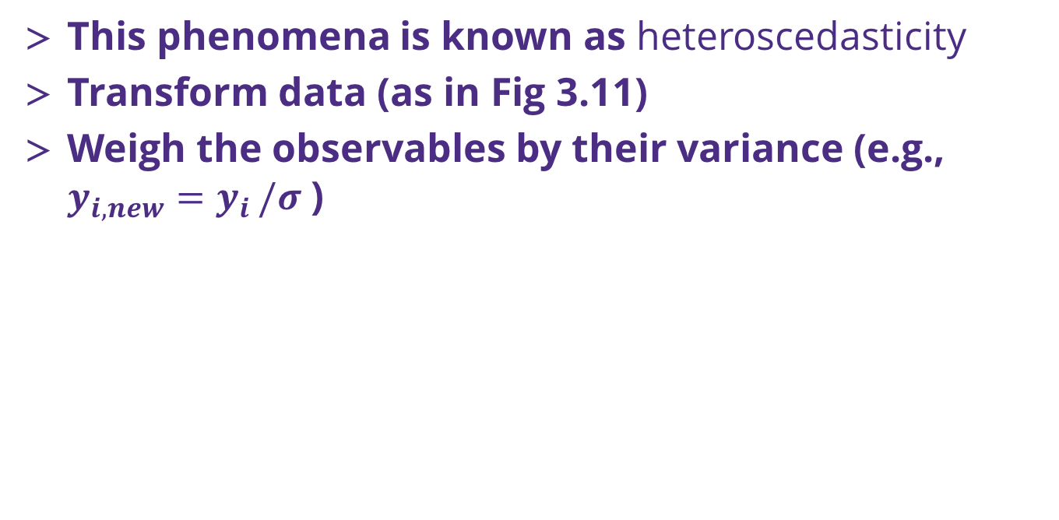
Nonlinear variance
This phenomena is known as heteroscedasticity
Transform data (as in Fig 3.11)
Weigh the observables by their variance (e.g., $y_{i,new}=y_{i }/σ$ )

Slide 40
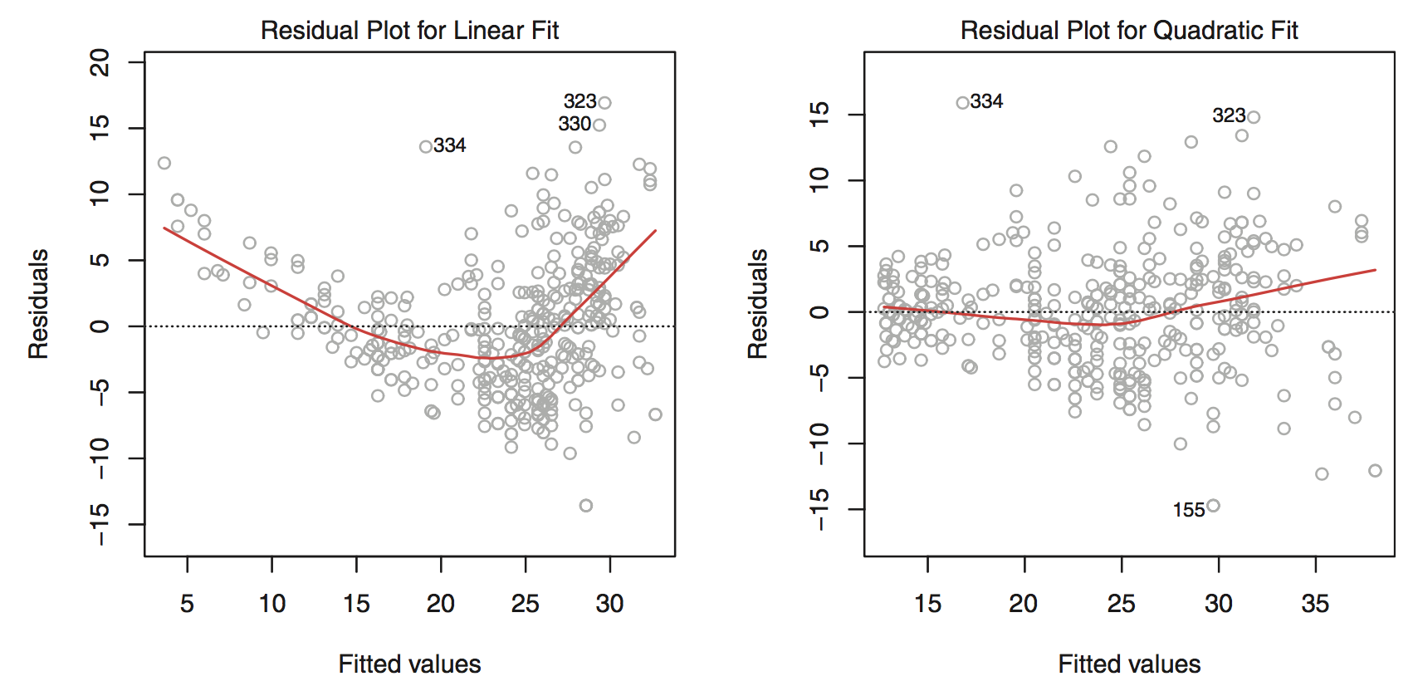
Intro to nonlinear regression
Sometimes your variables have a clear non-linear dependence on the response
This is especially clear when you look at the residuals (ISL Fig 3.9)

Slide 41
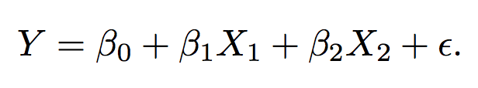
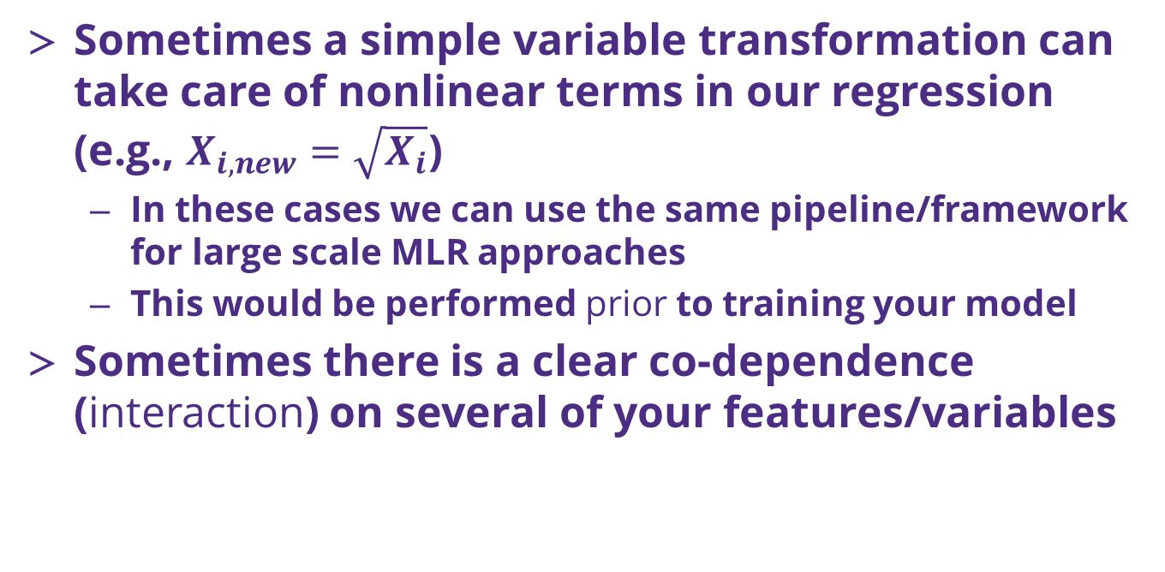
Simple types nonlinear regression
Sometimes a simple variable transformation can take care of nonlinear terms in our regression (e.g., $X_{i,new}=\sqrt{X_{i}}$)
In these cases we can use the same pipeline/framework for large scale MLR approaches
This would be performed prior to training your model
Sometimes there is a clear co-dependence (interaction) on several of your features/variables

Slide 42
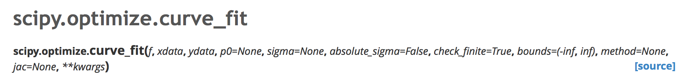
Where to go when you have a true nonlinear model to fit/train?
In general, the packages in scikit-learn work for general linear (single or multiple) or very specific types of nonlinear (e.g., splines) models of Y
The reason why has to do with speed of model solution and large training data set sizes
Other Python packages can also perform regression

Slide 43
Moving from exact solution to finding a minimum MSE
When we leave the world of ”exact solutions”, we are then confined to using numerical solutions to find the minimum value of MSE(β_{i})
Do we need an initial guess? (yes!)
What should it be?
A lot of our machinery for assessing the models still works just fine!

Slide 44
Other topics / suggestions
Chapter 3 of ISL is strongly suggested to read carefully (maybe multiple times)
Additional topics we didn’t cover
Outliers and high leverage points in your training set
Collinearity
More about nonlinear regression
AND MANY MORE!

Slide 45
Resampling methods (CH5, ISL)
Resampling concept
Doing more with your data
A big warning: as introduced today, the resampling schemes are not to be used to generate independent predictions (of Y) for averaging later.
This is a concept related to ‘ensemble’ methods, which we will discuss soon

Slide 46
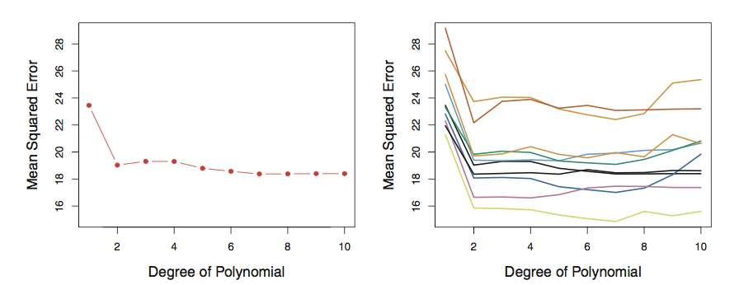

Cross Validation (k-fold)
Suppose you have one set of data and you have to decide how to break it into pieces for training and validation
Simplest approach is the “validation set” , just break it into two pieces
Example (Fig 5.2) looking at variations on $Y=β_{0}+β_{0}+X^{n}$
Left: training MSE vs n for one data set
Right: training MSE vs n for 10 validation sets
Riddle me this, how many ways are there to choose two 500 data sets from 1000?

Slide 47



Cross Validation (k-fold)
Since you only use a portion of your data in the training, the ”validation set” approach will tend to overestimate your error!
Leave One Out Cross Validation approach

Slide 48



Cross Validation (k-fold)
LOOCV is way more accurate (Fig 5.4), but more computationally expensive!
An alternate is to break the data into larger pieces than n and n-1
We break it into “k” folds of data, e.g. 5-fold. The 1st set is saved for validation, remaining k-1 sets are used for training

Slide 49
Bias/variance tradeoff: use 5 or 10 folds
Bias
an error from erroneous assumptions in the learning algorithm. High bias can cause an algorithm to miss the relevant relations between features and target outputs (underfitting).
Variance
an error from sensitivity to small fluctuations in the training set. High variance can cause an algorithm to model the random noise in the training data, rather than the intended outputs (overfitting).
Bias variance tradeoff relates the simplification of a model to avoid overfitting to the complexity of a model to avoid underfitting.

Slide 50

Bias/variance tradeoff: use 5 or 10 folds
Bias
Empirically people usually use 5 or 10 folds to avoid too much bias or variance in their resampling algorithm
This is a great way to get a true estimate of your model’s MSE
Fig 5.6 revisits Fig 2.9 in the context of k-fold cross validation

Slide 51
Bootstrap
The bootstrap is one of the most versatile tools you will use in statistical analysis of data sets
It involves resampling with replacement from your data set
Algorithm:
Randomly draw, with replacement, some subset from your training data
Train your model and make an estimate of your coefficient and MSE
Rinse and repeat until the errors converge

Slide 52

The power of the bootstrap in one figure
Fig 5.10, estimates of some parameter, α

Slide 53

Take care
Depending on how large your bootstrap sample data set is, I recommend you avoid using the standard error formula (Eq 5.8) and instead you should use simply the standard deviation of the bootstrap estimates.
Can anyone explain why?
In this context α, could be any quantity from your training procedure (MSE, β, etc..)

Slide 54
What’s next?
HW 4!
Should be available by the end of the day.

